Slide 3
PELMANISM

Slide 4
1
2
3
4
swim
won
win
started
5
6
7
8
see
play
decided
decide
10
played
swam
9
11
12
start
saw

Slide 5
How was your weekend?

Slide 6
UNIT 6
SPORTS
Lesson 6: SPEAKING

Slide 7
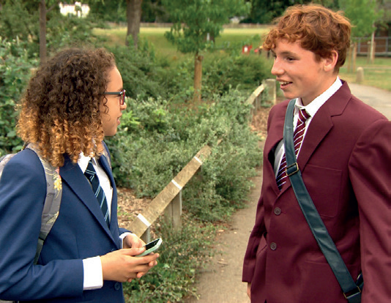
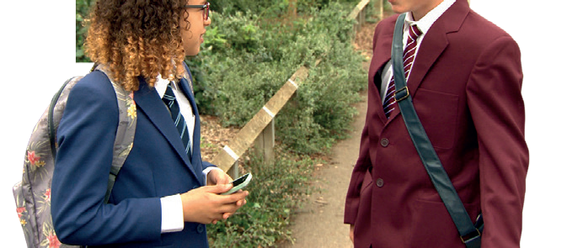
Who are they?
Lois
Alfie

Slide 8
Complete the dialogue. Then watch or listen and check. Why was Alfie happy on Saturday?
Alfie : Hey, Lois. How are things? Lois : Oh hi, Alfie. Good, thanks. How (1) _______ your weekend? Alfie : It (2) _______ great, thanks. I (3) ________ to a football match on Saturday.
Lois : Really? (4) ________ it good?
Alfie : Yes, it was brilliant. There (5) _______ a lot of goals. United (6) _______ 3–2 in the end.
Lois : That’s good news! Who (7) ________ you with?
Alfie : My brother. Why don’t you come next time?
Lois : Sure. Why not? Text me when you’re going, OK?
Alfie : OK then. Bye, Lois.
Lois : Bye.
was
was
went
Was
were
won
were

Slide 9
Look at the Key Phrases. Cover the dialogue and try to complete the Key Phrases. Then watch or listen and check.

Slide 10
KEY PHRASES
Talking about the weekend
1) __________ was your weekend? 2) __________ good / bad news! 3) __________ were you with? 4) __________ don’t you come next time? 5) Sure. _________ not? 6 ) Text me __________ you’re going.
How
That’s
Who
Why
Why
when

Slide 11
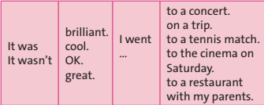
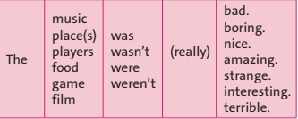
Look at the phrases. Then listen to three mini-dialogues. Which phrases do you hear?

Slide 12
Look at the phrases. Then listen to three mini-dialogues. Which phrases do you hear?
It wasn’t great. I went to the cinema on Saturday. The film was really boring.
2) It was brilliant. I went to a tennis match. The game was amazing.
3) It was OK. I went to a restaurant with my parents. The food was nice.

Slide 13
Pair-work

Slide 14
Practise mini-dialogues using the phrases in exercises 2 and 3.
Example:
* Student 1: How was your weekend?
* Student 2: It was great. I went to the restaurant with my parents and the food was so delicious. You should go there and try.
* Student 1: Sure. Why not?

Slide 15
Work in pairs. Look at the pictures. Imagine that you went to a football match or basketball game last weekend. Prepare and practise new dialogues with the phrases in exercises 2 and 3.

Slide 16
OPTIONAL ACTIVITY

Slide 17
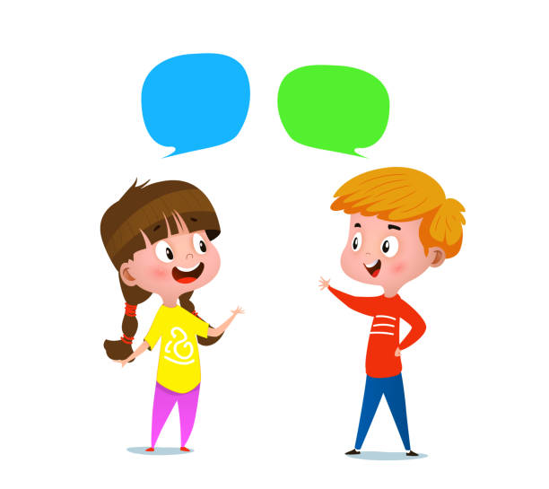
Make a dialogue to tell your partner what you really did last weekend.

Slide 18
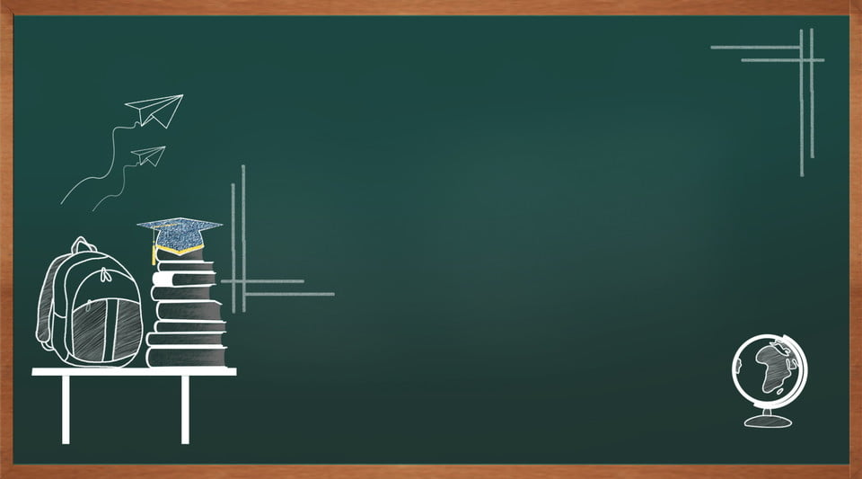
Homework
- Learn by heart all structures.
- Write some sentences about your last weekend, using the Key Phrases in exercise 2 and 3
- Prepare the next lesson: WRITING

Slide 19
www.phuongnam.edu.vn

Slide 20
Thank you!
CTCP ĐẦU TƯ VÀ PHÁT TRIỂN GIÁO DỤC PHƯƠNG NAM

